Slide 1
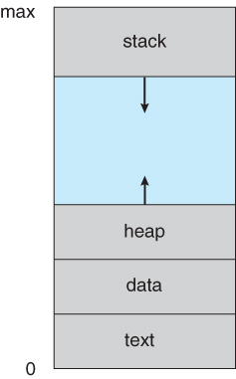
Process Concept
Process: The program which is under exectuion
Processor: The processor which executes the process (CPU)
Process in memory: Every process in main memory is represented as below format
Text segment is also called as code segment. it stores the instructions of the program.
Data segment: it mainly stores static and global variables.
Heap segment: It mainly store variables whose memory is allocated at run time(ex pointers)
Stack segment: It is also called as function stack. mainly used to store function parameters,local variables and return variables.

Slide 2
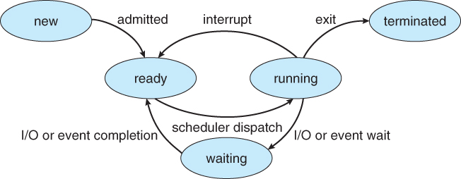
Heap grows up and stack grows down
in some programs stack memory is more such cases stack is grows. some programs heap memory is more in such case heap grows.
Process state: process may be one of the following 5 states.
New: The process is being created.it means program is loading from Hard disc to main memory.
ready: The process is ready for execution. it is waiting for cpu to execute the process.it contains list of processes schedular picks one process from the ready state allocated to the cpu.
running:The cpu is executing the process.if high priority process comes into the ready state then os will says an interupt. so cpu stop the execution of current process and process send to ready state.cpu starts the execution of high priority process.

Slide 3
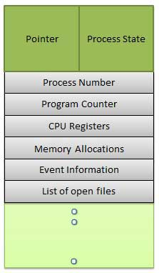
while executing the process in cpu that process require any I/O operation that time cpu is idle.os transfer that process from running state to waiting and os picks new process from ready state to running state.
If a process completes the execution then process moved to terminated state. process will be transfered from M.M to S.M
Process control block: PCB
Every process in the os is represented with the help of PCB
Every process has its own PCB
it contains information about process.

Slide 4
pointer:points to the another PCB.
Process state: it represents new,ready,running,waiting,terminated.
process number: for each process we have unique identifcation number that id is called as process number.
program counter: program counter contains address of the next instruction to be executed.
cpu register:it is used to store the data. cpu can not perform operations directly.
ex: c=a+b a is stored in one register and b is in other.
CPU scheduling information:
it stores the scheduling information about process.
priority scheduling algorithm the priority information is stored
round robin algorithm time quantum information is stored.
Memory management information: In order to manage memory efficiently os mainatins base registers,limit registers, page table,segement table
base register points the starting address of the register
limit register used to find the length of the register.

Slide 5
Accounting information: it stores information about CPU.
how much time cpu execute the process
it maintain the CPU statistics
ex: if process takes 15 seconds to complete the execution. 5 seconds done remaining 10 seconds need to complee the execution.
List of open files: in order to execute a process sometimes we need to open some files. the files which are open to execute a process.
List of I/O devices: what are the I/O devices are allocated to the process.
Operations on processes:
Process creation
Process termination
A parent process can create several child processes. Child processes can create its own child processes.
Resource sharing:Whenever a parent process creates a child processes then the parent process can share all the resources to children. or share some resources or never share any resource to children.(ex resources cpu,memory,i/o,files)

Slide 6
Execution: How parent process and child process gets executed
Parent process and child process can execute concurrently
parent process has to wait until the child process completes its execution
Address space for the child process
a)child is duplicate of parent
b)child process may be loaded with new process
examples:
fork system call creates a new process.
exec system call replacess newly created process with a new process.
creating a process using fork():
it is used to create a new process. the new process is called as child process. which is an exact replica or duplicate of copy of the parent process.
the process from which where we call the fork() system call is known as parent process.
the duplicate process is created is called as child process
parent process and child process will have different process ids

Slide 7
after fork() system call both parent and child process run independently. each has its own memory space and resources
the fork() system call is available in <unistd.h> header file.
the fork() system call returns the follwoing values -1,0, +ve integer
-1 means child process creations failed
0 means child process created
return +ve integer for parent process
#include<stdio.h>
#include<unistd.h>
#include<sys/types.h>
int main()
{
pid_t q;
q=fork();//q contains child process pid no

Slide 8
if (q<0)
{
pf(“child not created”);
}
else if (q==0)//child process created
{
pf(“\n child having id %d”, getpid());
pf(“\n parent id %d”,getppid());
}
else if (q>0)//parent prcoess
{
pf(“\n parent id %d”, getpid());
pf(“\n child id %d”, q);
}}

Slide 9
no of times process id is printed is equal to the no of times process created.total no of process=2 power n(no of process).
#include<stdio.h>
#include<unistd.h>
main()
{
fork();
fork();
fork();
pf(“porcess id %d”,getpid();
}

Slide 10
vfork(): It is also used to create child process. child process suspends execution of parent process until child process complete its execution.
#include<stdio.h>
#include<unistd.h>
#include<sys/types.h>
int main()
{
pid_t pid;
pf(“parent \n”);
pid=vfork();
if(pid==0)
{
pf(“child \n”);
return o;
}

Slide 11
Differences b/w fork() & vfork()
fork() | vfork()
in fork system call child & parent have separate memory space | in vfork system call child & parent process shares same memory space
two process get executed simulataneously | child process completes then only parent process complete its execution
child process dosen't suspend parent process execution | child process suspends parent process execution
space is wastage | no space wastage

